Slide 1
Pavement Defects Detection Based on Yolov5 and Generative Adversarial Network
DSPS Conference 2022
Group Members:
Tianjie Zhang,
Steven Kim,
Amanda Mullins,
Yang Lu
Mar. 23, 2022

Slide 2
Overview
Introduction
Data
Methodology
Results
Conclusion
Notes:
Speak out all points

Slide 3
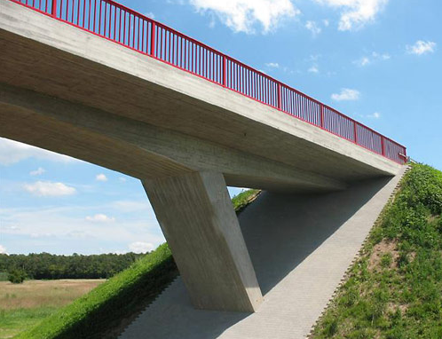
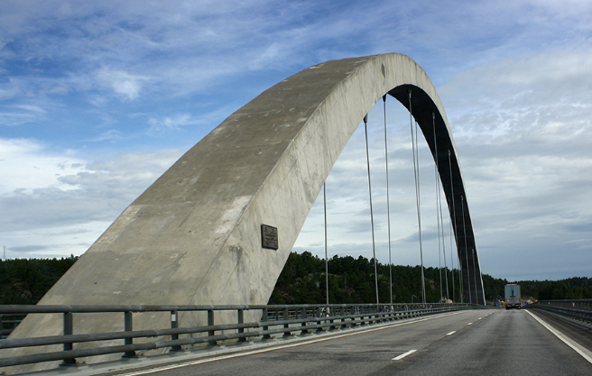
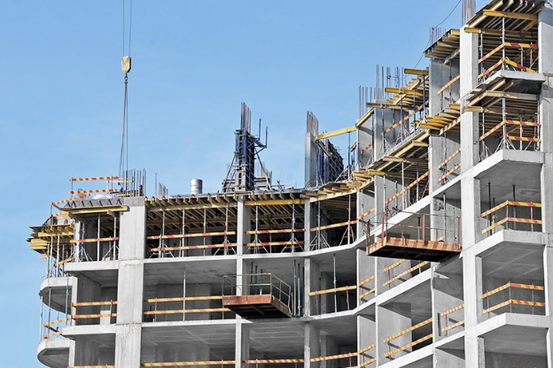
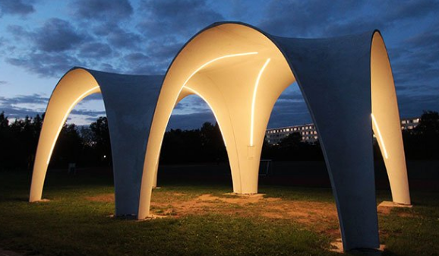
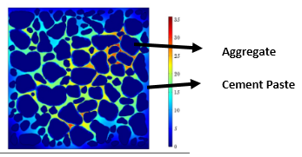
Introduction
Pavement distresses:
Cracking
alligator
transverse
block
longitudinal
Patching
Sealing
Manholes
Picture Credit: change the images
Intelligent pavement detection and identification becomes a significant task.
Notes:
Tranditional detecting methods are time-consuming and laber-intensive. Thus,

Slide 4
Introduction
Conventional Methods
Machine Learning
Deep Learning
Picture Credit: change the images
Notes:
First thing first, what is concrete? Essentially of two phases…
You all know about concrete from civil engineering background, however a brief idea
Speak out all points in brief
*Can be skipped in the concrete specialized presentation

Slide 5
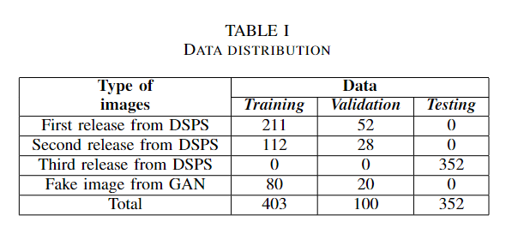
Data
Fake images
From GAN
Annotation: by team members
Real images
From: Organizers of DSPS22 (Kansas city, Jefferson city, Columbia, Missouri)
By: Google Street View and ARAN Vehicles
Distress: 7 main distress types
Resolution: 2011×1014 pixels
Training: 323
Tuning: 80
Testing:352
The second release data was annotated by our team members while the first release was annotated by Sponsor.
Training and Tuning data are not enough for training and validating the model.
Notes:
So the logic in annotate these distresses are different. It may cause a decrease in test accuracy. However, I think it is necessary. As we know, there should be many engineers who will annotate the road images. Each person has his/her own understanding of the defects. We called it bias. So, by introducing the second release, the robust of the model would be improved a lot which means more than a little drop in accuracy.

Slide 6
Methodology
Improve the accuracy of YOLOv5
Purpose
Data cleaning
Annotation
Augmentation
Data-centric statistics
Image Preprocess
Increase Bias
GAN
Strategies
Gaussian Filter
Histogram equalization
Normalization

Slide 7
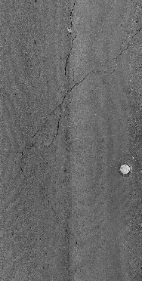
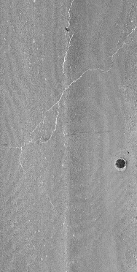
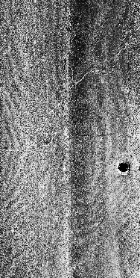
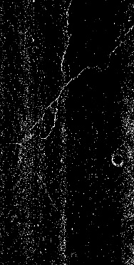
Methodology
Preprocess
To: Denoise the Images
(a)
(b)
(c)
(d)
Raw image
Gaussian Filter
Histogram equalization
Normalization: To make the pixel mean equal to zero

Slide 8
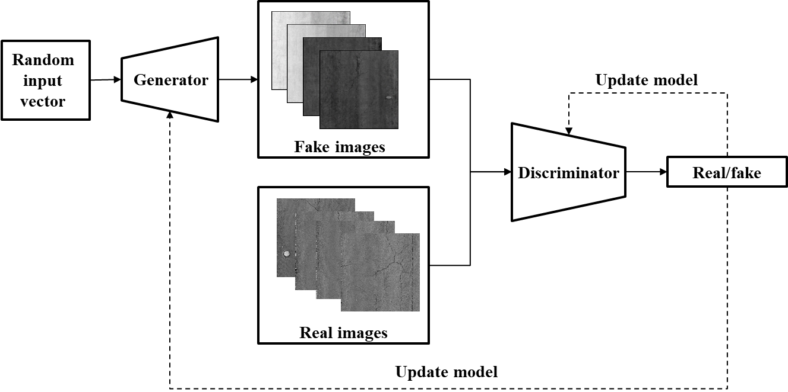
Methodology
Generative adversarial network (GAN)
A class of ML frameworks
Contains two neural networks (G and D) contest with each other
Notes:
The G will generate new images with the same statistics as the training set. And the discriminator will evaluate the results from G. the G ‘s work is to increase the error rate of the discriminative network.

Slide 9
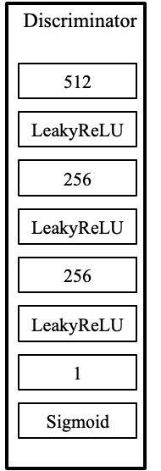



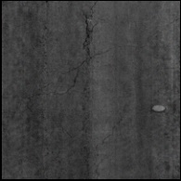
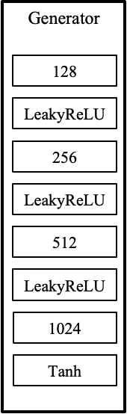
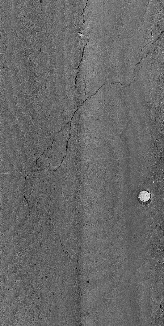
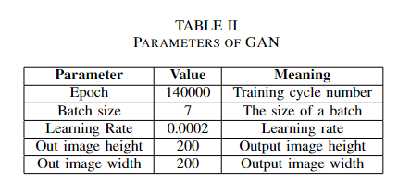
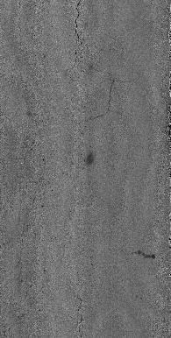

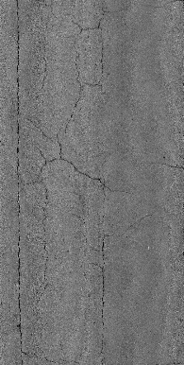
Methodology
Random input vector
Generator:
Deep Neural Network with three hidden layers.
Discriminator:
Deep leaning network with three hidden layers
Fake images
Update
model
Real images
Real/fake
Update model
Notes:
First thing first, what is concrete? Essentially of two phases…
You all know about concrete from civil engineering background, however a brief idea
Speak out all points in brief
*Can be skipped in the concrete specialized presentation

Slide 10
Methodology
Pavement images
Training
Yolov5
Testing
GAN
Annotation
Validation
The overall procedure
The goal is to train the pavement distress detection model Yolov5, allowing it to learn the features of pavement distresses, and target the objects in top-down view images. Thus, in this work, what we contributes is in the amount of images
Notes:
The pavement images are used to train the GAN model to produce realistic images. Both the real and generated fake images are annotated and split into training data and validation data.

Slide 11
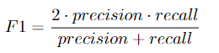
Methodology
Evaluation Metrics
The result is evaluated by F1 score. The F1 metric weights recall and precision equivalently, acting as a good retrieval algorithm, maximizing both precision and recall simultaneously.
Notes:
The pavement images are used to train the GAN model to produce realistic images. Both the real and generated fake images are annotated and split into training data and validation data.

Slide 12
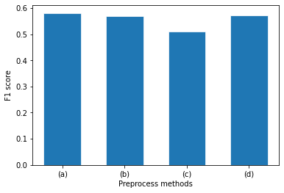
Results
Preprocess
The F1 score decreases after applying the preprocess methods
Image preprocessing may not be a wise decision
(a)
(b)
(c)
(d)
Raw image
Gaussian Filter
Histogram equalization
Normalization: To make the pixel mean equal to zero
Notes:
To analyze why accuracy decreased, the tradeoffs from the preprocessing methods negatively affected our dataset. The Gaussian filter narrows down the boundaries between defects and background, thus reducing the accuracy. The histogram equalization sharpens the contrast; however, the feature of the non-defect area would widen, impacting the accuracy of the model. Subtracting the average value in the pavement image removes the background and noise, along with some useful features from the distress. Thus, image preprocessing in this task may not be considered a wise decision. To improve the model's F1 score, increasing the size of the data set becomes the most optimal choice.

Slide 13

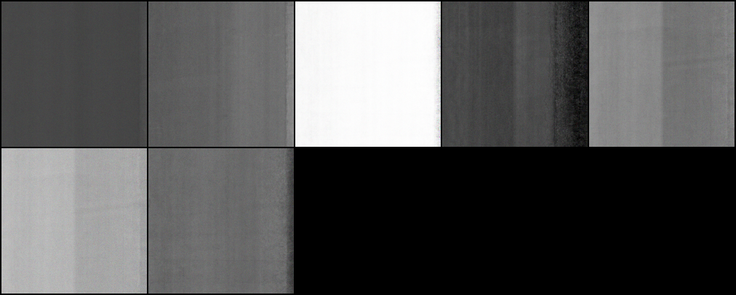

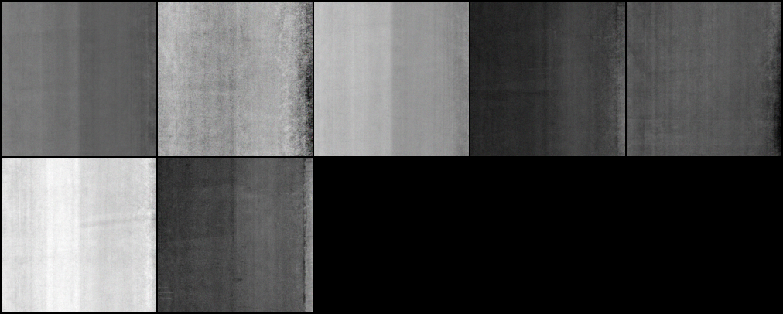
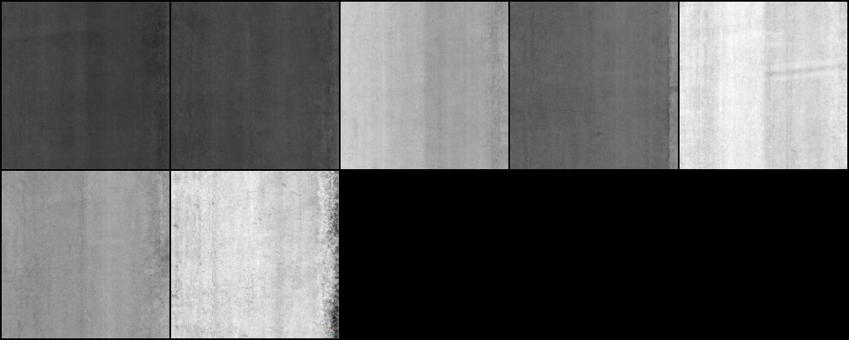
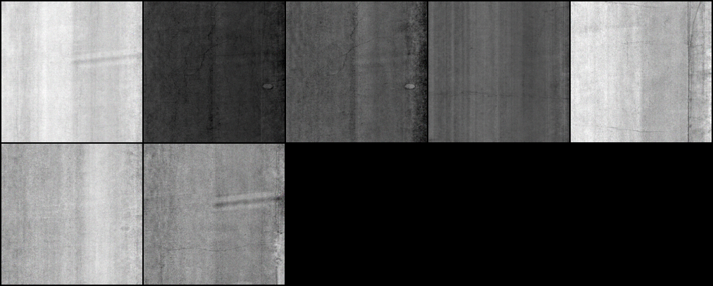
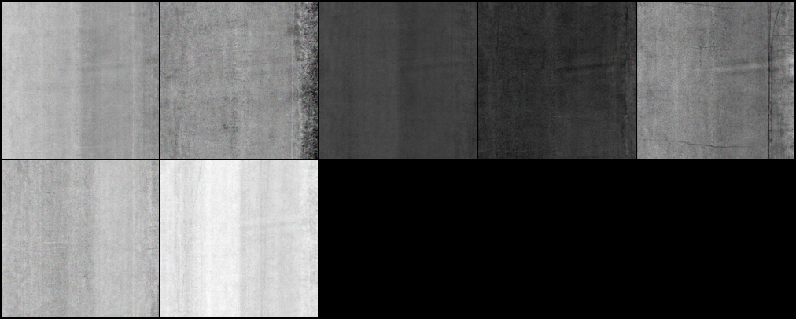
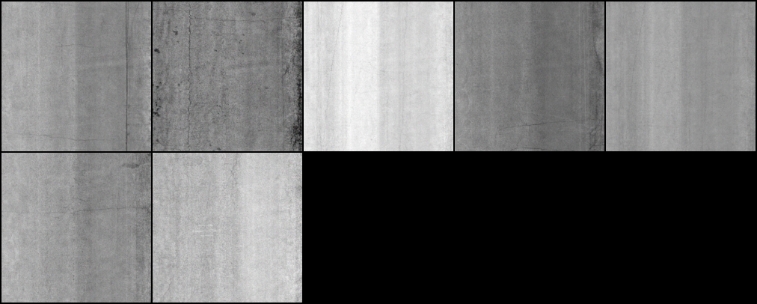
Results
GAN
0
20000
40000
60000
80000
100000
120000
140000
Notes:
To analyze why accuracy decreased, the tradeoffs from the preprocessing methods negatively affected our dataset. The Gaussian filter narrows down the boundaries between defects and background, thus reducing the accuracy. The histogram equalization sharpens the contrast; however, the feature of the non-defect area would widen, impacting the accuracy of the model. Subtracting the average value in the pavement image removes the background and noise, along with some useful features from the distress. Thus, image preprocessing in this task may not be considered a wise decision. To improve the model's F1 score, increasing the size of the data set becomes the most optimal choice.

Slide 14
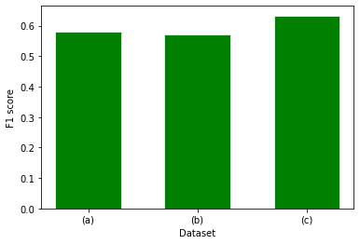
Results
GAN
The addition of fake images brought an increase in the F1 score of 0.633 compared to the raw data accuracy of 0.581.
0
20000
40000
60000
80000
100000
120000
140000
The first release annotated by DSPS;
+the second release annotated by team members;
+the selected 100 fake images.
Notes:
While in the 0 iteration of GAN, the fake image totally consisted of random noise. However, after 100000 epochs of training, the pavement surface image generated by the GAN model is quite similar to the real image, although the area around the distress is still slightly distorted. Thus, 100 fake images were selected after 100000 epochs as an another source of data. The Yolov5 model was tested by using different amount of images.
The addition of the second batch of images resulted in a decrease in the F1 score. The first batch and the testing data were annotated by sponsors of DSPS22, who might have diverse standards when it comes to annotating images. Thus, the outcome would be affected due to their definition of distress, which explains the small drop in the F1 score. Nevertheless, self-annotated images are necessary to the training and validation data, since it is considered as a tradeoff between the accuracy and the model's robustness. The addition of fake images brought an increase in the F1 score of 0.633. The improvement is considered significant, compared to the raw data accuracy of 0.581.

Slide 15
Conclusion
1. Image preprocessing methods such as histogram equalization, Gaussian filter and image normalization decrease the F1 score of the test result showing not a wise way in road distress inspection.
2. GAN can produce fake images to enlarge the amount of train data, as deep learning depends a lot in quality and quantity in the dataset.
3. In the overall procedure, based on the YOLOv5 object detection model, the GAN gains its importance in image augmentation and promotes a better result in the pavement distress inspection.

Slide 16
Thank You
Tianjie Zhang
Boise State University
Email tjzhang@u.boisestate.edu

Slide 17
Introduction
Conventional Methods
Machine Learning
Deep Learning
Picture Credit: change the images
Notes:
First thing first, what is concrete? Essentially of two phases…
You all know about concrete from civil engineering background, however a brief idea
Speak out all points in brief
*Can be skipped in the concrete specialized presentation

Slide 18
Introduction
Conventional Methods
Machine Learning
Deep Learning
Picture Credit: change the images
Notes:
First thing first, what is concrete? Essentially of two phases…
You all know about concrete from civil engineering background, however a brief idea
Speak out all points in brief
*Can be skipped in the concrete specialized presentation

Slide 19
Introduction
Conventional Methods
Machine Learning
Deep Learning
Picture Credit: change the images
Notes:
First thing first, what is concrete? Essentially of two phases…
You all know about concrete from civil engineering background, however a brief idea
Speak out all points in brief
*Can be skipped in the concrete specialized presentation

Slide 20
Concrete
Classification:
Composite Material
Composition:
Portland Cement & Water
Fine & Coarse Aggregate (i.e. Sand and Brick Chips)
Organization:
Anisotropy: Different aggregate (CA) size.
Isotropic: For simplicity
Function:
Qualitative:
Time dependency
Non-linearity
Elasticity
Plasticity
Creep & Shrinkage
Viscoelasticity
Quantitative¹:
Density: 2240-2400 kg/m3
Compressive strength: 20-40 MPa
Tensile strength: 2-5 MPa
Modulus of Elasticity, E: 14-41 GPa
1.https://www.engineeringtoolbox.com/concrete-properties-d_1223.html
Notes:
These are concrete characteristics
Speak out all points in brief
*Can be skipped in the concrete specialized presentation

Slide 21
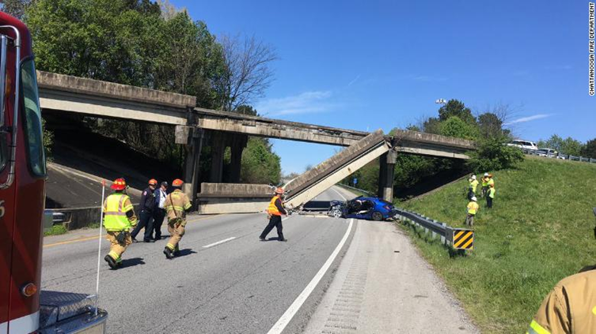

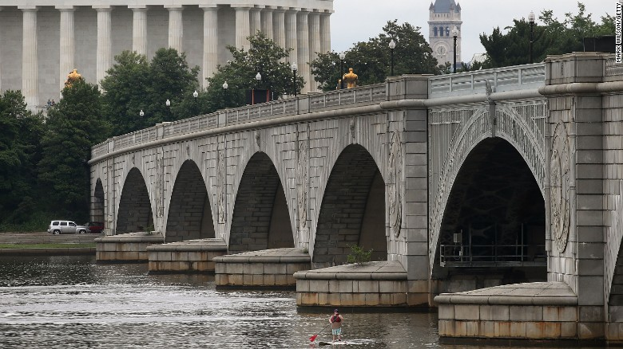
Concrete Damage
Concrete Damage is more frequent nowadays
CNN Newsletter April 3, 2019
47,052 bridges need urgent repairs in USA and the states with the most structurally deficient bridges are:
Rhode Island (23%)
West Virginia (19.8%)
Iowa (19.3%)
South Dakota (16.7%)
Pennsylvania (16.5%)
Maine (13.1 percent)
Louisiana (13 percent)
Puerto Rico (11.7 percent)
Oklahoma (10.9 percent) and
North Dakota (10.7 percent)
https://www.cnn.com/2019/04/02/us/deficient-bridge-report-2019-trnd/index.html
https://www.cnn.com/2019/04/02/us/deficient-bridge-report-2019-trnd/index.html
Notes:
Now what is concrete damage or why we should do concrete damage analysis.
Hit next and show slideshow of sub-title, speak out sub-title.
According to newsletter published on CNN, April 3, after a bridge collapse in Tennesse, Chattanoga.
Speak out all points in brief
*Can be skipped in the concrete specialized presentation

Slide 22
Concrete Damage
2019 Bridge Report, American Road & Transportation Builders Association (ARTBA)
235,020 (38 percent) of U.S. bridges have identified repair needs.
At the current pace it'll take 80 years to repair all the structurally deficient bridges in the US
And the cost to make the identified repairs for all 235,000 bridges is nearly $171 billion
According to ARTBA, one remedy is the restrictions or other measures in place to reduce stress on the structure.
Major reasons for the detrimental stress are:
Aging of concrete
Detrimental chemical reaction, i.e. ASR
Environmental effects
Mechanical loadings etc.
Notes:
38 percent of U.S. bridges have identified repair needs.
At the current pace it'll take 80 years to repair all the structurally deficient bridges in the US. And a lot more money.

Slide 23
Volume stability: Shrinkage/Expansion Induced Damage
Chemical Phenomena
Alkali-Aggregate Reaction (AAR)
Chloride or Sulfate Attack
Carbonation of concrete
Other corrosive elements
Physical Phenomena
Thermal strain
Hygroscopic swelling
Freeze-Thaw cycle
Creep/Aging
Mechanical loads
Notes:
Within this context I am working on these phenomenon. From chemical I am considering this.. And from physical I am considering these…

Slide 24
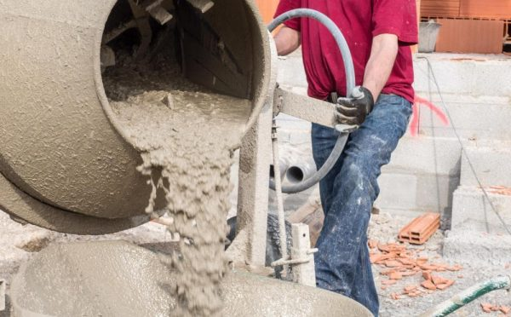
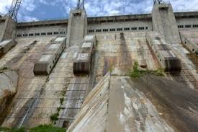
Alkali-Aggregate Reaction (AAR)
Concrete = water+ aggregate (rock, sand, or gravel) + Portland Cement
Concrete become stable after chemical reaction between it’s different elements where Cement acts as a binding agent
Reactive aggregate can initiate undesirable chemical reaction
AAR= reactive aggregate + alkali hydroxides from Portland cement
Develop crack in concrete structure over time
One of the major sources of concrete service life deterioration
https://gharpedia.com/different-methods-mixing-concrete/
https://www.plewall.com/post/alkali-aggregate-reaction-in-concrete-and-its-remedies/
Notes:
AAR is one of the major sources of concrete service life deterioration. Though aggregates are chemically inert to a certain extent, reactive aggregate can initiate undesirable chemical reaction. It can damage dams, bridges, nuclear plan and so on. Describe in brief.

Slide 25
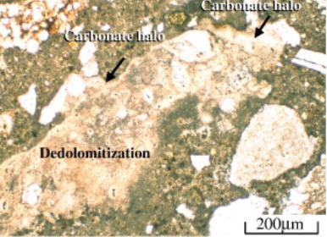
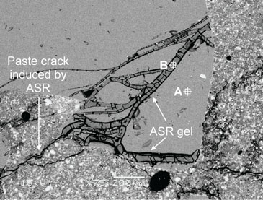
Alkali-Aggregate Reaction (AAR)
Alkali-carbonate reaction (ACR):
Hardly seen and generally formed with dolomitic or ACR-susceptible aggregates
Alkali-silica reaction (ASR):
Common source of concrete deterioration worldwide and is of more significance in the United States.
AAR Types
https://www.sciencedirect.com/science/article/pii/S0008884609002737
http://saplnh.org/about-nuclear/concrete-degradation-at-seabrook/
Our Research focus is Alkali-Silica Reaction in the model prediction.
Notes:
Describe in brief. Carbonate Halo means circular/annular ring of carbonates. Dolomitic crystals. Small sized discrete dolomite crystals suspended in the clay contents/mortar. ASR gel formed with the reaction between silica(reactive agg.) and ROH (cement paste).

Slide 26
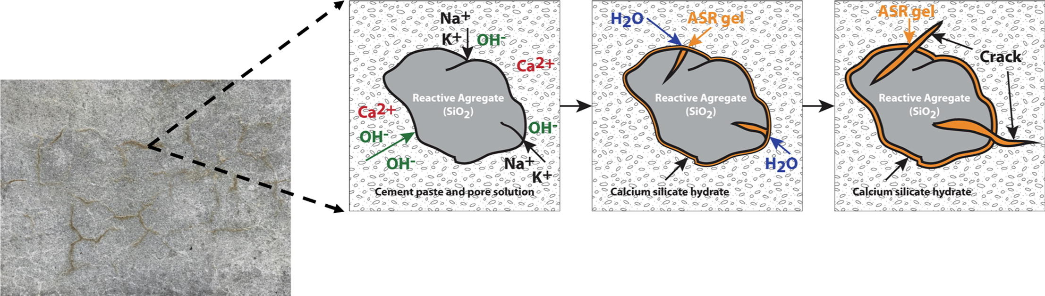
Alkali-Silica Reaction (ASR)
https://www.sciencedirect.com/science/article/pii/S0950061819318811
Silica (reactive aggregate)+ alkali hydroxide (cement) = ASR (solid)
ASR(solid)+water = ASR gel
Expansive gel = internal pressure = Cracking in concrete
An expansive and destructive marriage
A concrete cancer
Notes:
In ASR, aggregates containing silica will react with alkali hydroxide in concrete which form alkali silica gel in a solid form. This gel further swells when it absorbs water from surrounding cement paste or the environment and induce increasing internal pressure in the cementitious matrix of concrete structure. This pressure may initiate expansion and develop crack in concrete materials.The mechanisms governing ASR are quite complex.

Slide 27
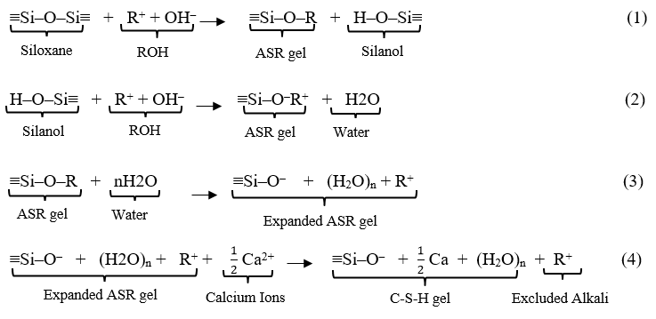
ASR Chemophysics
ASR occurs in multi-step:
where, R⁺ denotes an alkali ion (K⁺ or Na⁺).
Notes:
An acid-base reaction:
Stage 1: Hydrolysis (Eqn. 1): Hydrolysis of the reactive silica (siloxane) by hydroxyl ions (OH‒) takes place.
Stage 2: Neutralization (Eqn.2): In the second stage, weak silanol bonds (≡Si–O–H) further react with hydroxyl ions to generate alkali-silicate gel.
Stage 3: Osmosis (Eqn. 3): Hydrophilic alkali-silicate gel imbibes water or moisture from hydrated cement paste or surrounding environment and increases in volume.
At last stage very slow ionic exchange by mutual diffusion between alkalis in ASR gel and calcium in cement paste results in the conversion of expansive alkali-rich ASR gel into non-expansive calcium silicate gel (CSH gel) per Eq. (4). This may happen during repeated drying and wetting or the freeze/thaw cycles which limit the ASR expansion. C–S–H mechanism is not considered in the chemical model of this study.

Slide 28
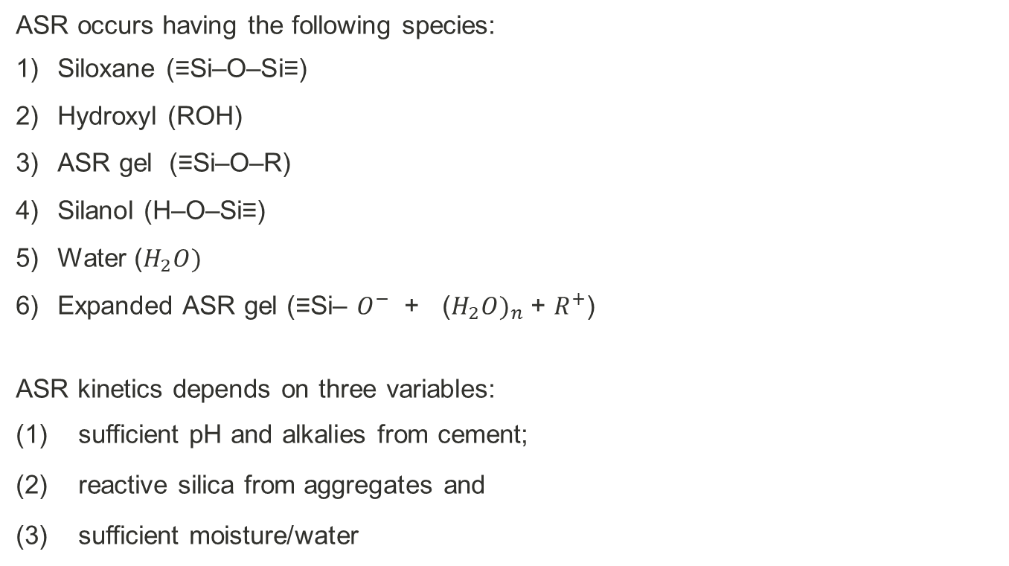
ASR Chemophysics
ASR occurs having the following species:
Siloxane (≡Si–O–Si≡)
Hydroxyl (ROH)
ASR gel (≡Si–O–R)
Silanol (H–O–Si≡)
Water ($H_{2}O)$
Expanded ASR gel (≡Si– $O^{−}$ + (${H_{2}O)}_{n}$ + $R^{+}$)
ASR kinetics depends on three variables:
sufficient pH and alkalies from cement;
reactive silica from aggregates and
sufficient moisture/water

Slide 29
Available Models
Notes:
Since 1940s, several research have been conducted to identify this expansive characteristic of the alkali-silica reaction.

Slide 30
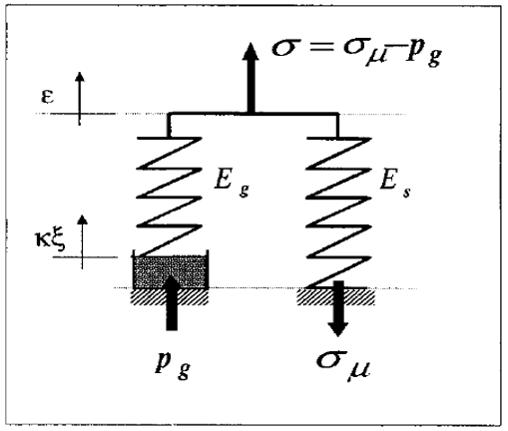
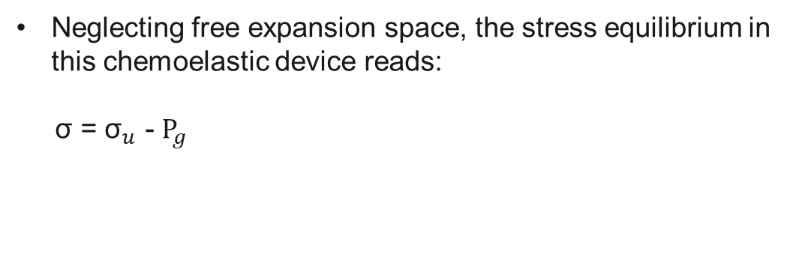
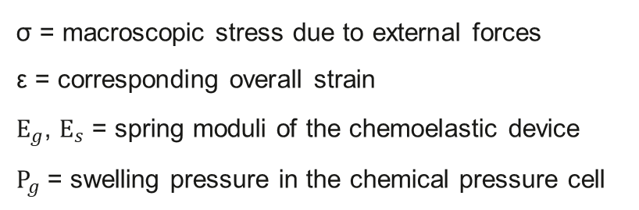
ASR expansion proposed by Franz-Josef Ulm ${\text{et} \text{al}\text{.}}^{1}$
Assuming an elastic material behavior of the skeleton for macrolevel material expansion.
σ = macroscopic stress due to external forces
ε = corresponding overall strain
$E_{g}$, $E_{s}$ = spring moduli of the chemoelastic device
$P_{g}$ = swelling pressure in the chemical pressure cell
stress in the elastic spring of stiffness $E_{s}$, ${\text{σ}}_{u}$ = $E_{s}$ ε
Neglecting free expansion space, the stress equilibrium in this chemoelastic device reads:
σ = ${\text{σ}}_{u}$ - $P_{g}$
1. Ulm, F.J., O. Coussy, L. Kefei, and C. Larive. Thermo-Chemo-Mechanics of ASR Expansion in Concrete Structures. Journal of Engineering Mechanics, 2000. 126: 233-242.
Notes:
To capture this expansive material behavior at a macrolevel of material description assuming an elastic material behavior of the skeleton. This is shown in Fig. 1(b) in the form of a parallel chemical pressure cell-spring device.

Slide 31
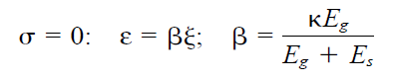
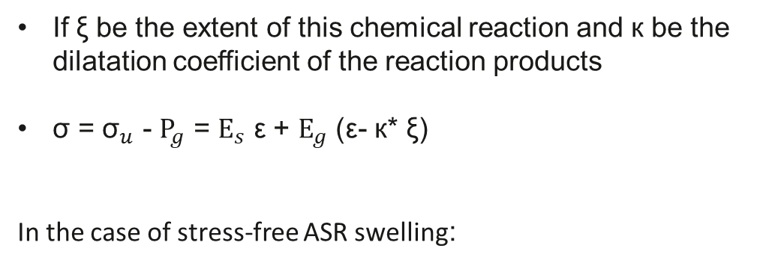
ASR expansion proposed by Franz-Josef Ulm ${\text{et} \text{al}\text{.}}^{1}$
If ξ be the extent of this chemical reaction and к be the dilatation coefficient of the reaction products
σ = ${\text{σ}}_{u}$ - $P_{g}$ = $E_{s}$ ε + $E_{g}$ (ε- к* ξ)
In the case of stress-free ASR swelling:
β is the chemical dilatation coefficient to the extent ξ [ [0, 1] of the ASR.
1. Ulm, F.J., O. Coussy, L. Kefei, and C. Larive. Thermo-Chemo-Mechanics of ASR Expansion in Concrete Structures. Journal of Engineering Mechanics, 2000. 126: 233-242.
Notes:
In the case of stress-free ASR swelling strain can be calculated from that equation....

Slide 32
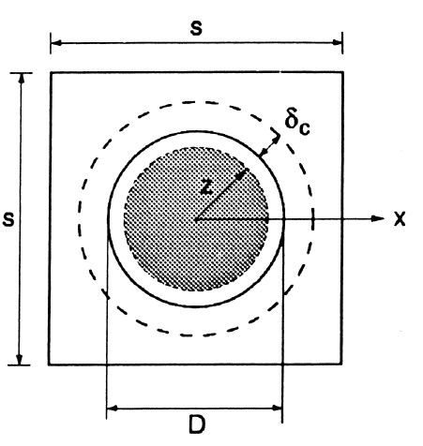
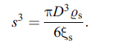
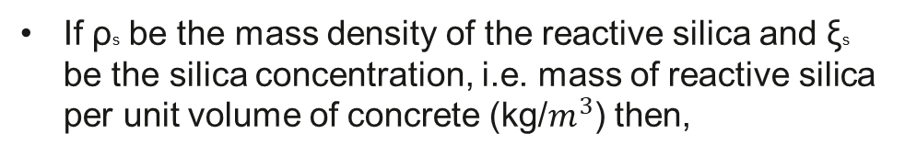
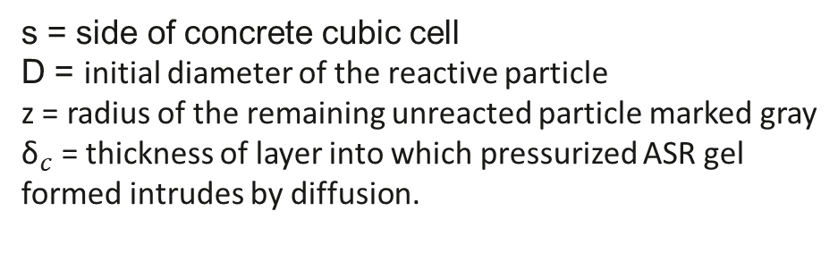
ASR expansion proposed by ${\text{Zdene}\text{Ï}\text{k} \text{P}\text{. }\text{Baz}\text{Ï}\text{ant}}^{2}$
A characteristic unit cubic cell of concrete containing one spherical glass particle is analyzed.
A spherical layer of basic ASR gel grows radially inward into the particle, controlled by diffusion of water toward the reaction front.
s = side of concrete cubic cell
D = initial diameter of the reactive particle
z = radius of the remaining unreacted particle marked gray
${\text{δ}}_{c}$ = thickness of layer into which pressurized ASR gel formed intrudes by diffusion.
If ρs be the mass density of the reactive silica and ξs be the silica concentration, i.e. mass of reactive silica per unit volume of concrete (kg/$m^{3}$) then,
2. Steffens, A., and Z. P. Bazant. Mathematical Model For Kinetics of Alkali-Silica Reaction in Concrete. Cemente and Concrete Research, 2000. 30: 419-428.
Notes:
Only one reactive particel.
del_c = thickness of layer with capillary pores and cracks into which pressurized ASR gel formed intrudes by diffusion.

Slide 33
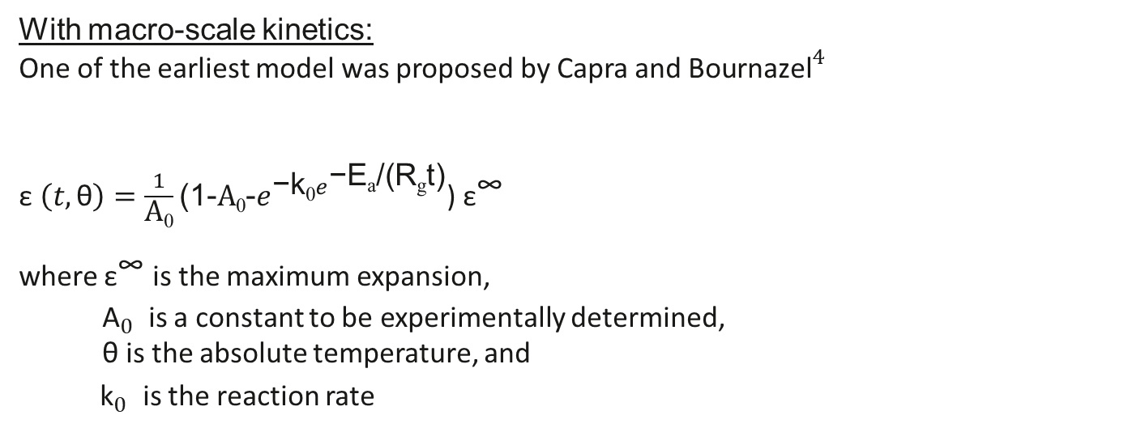
ASR expansion proposed by Victor E. Saouma ${\text{et} \text{al}\text{.}}^{3}$
Attempts to develop a mathematical framework through which the reaction kinetics can be better understood
With macro-scale kinetics:
One of the earliest model was proposed by Capra and ${\text{Bournazel}}^{4}$
$\text{ε} \left(t,\text{θ}\right)=\frac{1}{\text{A}\text{0}}\text{(}\text{1−}\text{A}\text{0}\text{−}e^{\text{−}\text{k}\text{0}e^{\text{−}\text{E}\text{a}\text{/(}\text{R}\text{g}\text{t}\text{)}}}$) ${\text{ε}}^{\text{∞}}$
where ${\text{ε}}^{\text{∞}}$ is the maximum expansion,
${\text{A}}_{0}^{}$ is a constant to be experimentally determined,
θ is the absolute temperature, and
${ \text{k}}_{0}^{}$ is the reaction rate
3. Saouma, V. E., R.A. Martin, M. A. Hariri-Ardebili, and T. Katayama. A Mathematical Model For The Kinetics of The Alkali–Silica Chemical Reaction. Cement and Concrete Research, 2015. 68:184-195
4. B. Capra, J.P. Bournazel, Modeling of induced mechanical effects of alkali–aggregate reactions, Cem. Concr. Res. 28 (2) (1998) 251–260.
Notes:
As all chemical reactions, ASR is a function of both time and temperature

Slide 34
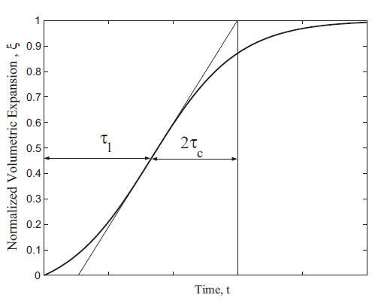
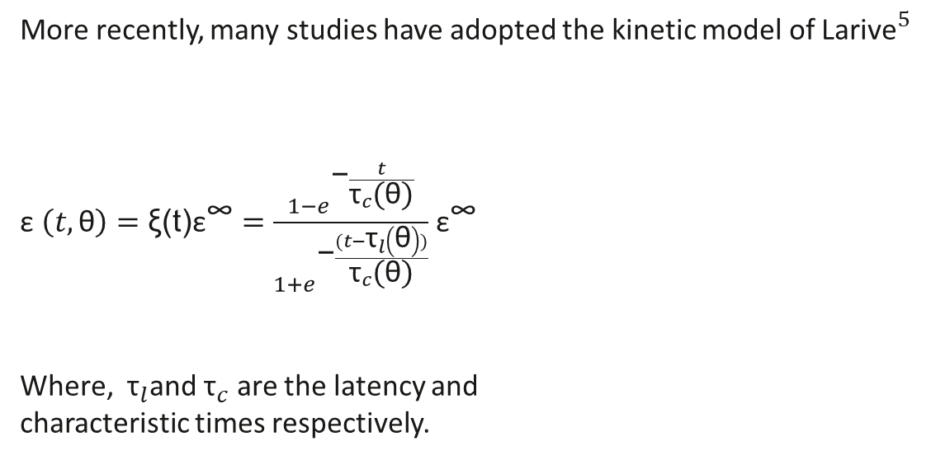
ASR expansion proposed by Victor E. Saouma ${\text{et} \text{al}\text{.}}^{3}$
More recently, many studies have adopted the kinetic model of ${\text{Larive}}^{5}$
$\text{ε} \left(t,\text{θ}\right)=\text{ξ}\text{(}\text{t}\text{)}{\text{ε}}^{\text{∞}}=\frac{1−e^{\text{−}\frac{t}{{\text{τ}}_{c}\text{(}\text{θ}\text{)}}}}{1+e^{\text{−}\frac{(t−{\text{τ}}_{l}\left(\text{θ}\right))}{{\text{τ}}_{c}\text{(}\text{θ}\text{)}}}}$ ${\text{ε}}^{\text{∞}}$
Where, ${\text{τ}}_{l}$and ${\text{τ}}_{c}$ are the latency and
characteristic times respectively.
These kinetic equations are empirical and applicable at a macro-scale study such as the finite element analysis of a dam.
3. Saouma, V. E., R.A. Martin, M. A. Hariri-Ardebili, and T. Katayama. A Mathematical Model For The Kinetics of The Alkali–Silica Chemical Reaction. Cement and Concrete Research, 2015. 68:184-195
5. C. Larive, Apports Combinés de l'Experimentation et de la Modélisation à la Comprehension del'Alcali-Réaction et de ses Effets Mécaniques(PhD thesis) Laboratoire Central des Ponts et Chaussées, Paris, 1998.
Notes:
${\text{τ}}_{l}$ is the time required to initiate the chemical reaction/expansion and within that period expansion is not visible. ${\text{τ}}_{c}$ defines how long reaction will stand under the present conditions.

Slide 35
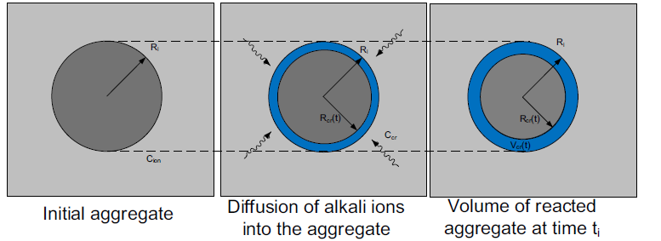
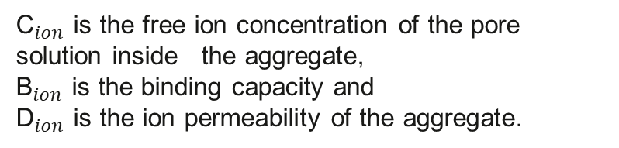


ASR expansion proposed by Victor E. Saouma ${\text{et} \text{al}\text{.}}^{3}$
Typically a single aggregate is modeled along with the cement paste.
With meso-scale model:
Penetration of alkali ions into the aggregate assumed to be governed by Ficks law:
$${\text{B}}_{ion}\frac{∂{\text{C}}_{ion}}{∂t} =∇.({\text{D}}_{ion}\left({\text{C}}_{ion}{\text{)}∇\text{C}}_{ion}\right)$$
${\text{C}}_{ion}$ is the free ion concentration of the pore solution inside the aggregate,
${\text{B}}_{ion}$ is the binding capacity and
${\text{D}}_{ion}$ is the ion permeability of the aggregate.
ASR occurs when, ${\text{C}}_{ion}$ = ${\text{C}}_{cr}$
3. Saouma, V. E., R.A. Martin, M. A. Hariri-Ardebili, and T. Katayama. A Mathematical Model For The Kinetics of The Alkali–Silica Chemical Reaction. Cement and Concrete Research, 2015. 68:184-195
Notes:
ASR occurs onlywhen Cion reaches a critical concentration Ccr. It should be noted that this is a slow and continuous process, and the moving front (where Cion = Ccr) varies with time t as shown in Fig.

Slide 36



ASR expansion proposed by Victor E. Saouma ${\text{et} \text{al}\text{.}}^{3}$
Typically a single aggregate is modeled along with the cement paste.
With meso-scale model:
The ASR gel permeation through the porous cement paste was assumed to be characterized by Darcy's law for a viscous flow as:
$$\frac{∂{\text{C}}_{gel}(t)}{∂t} =∇(\frac{K_{gel}}{η_{gel}}\left({∇\text{P}}_{gel}\left(t\right)\right))$$
${\text{C}}_{gel}(t)$ is the concentration of the gel,
$η_{gel}$ is the viscosity of the gel
$K_{gel}$is the gel permeability of the porous cement paste, and
${\text{P}}_{gel}\left(t\right)$ is the interface pressure distribution due to ASR gel
3. Saouma, V. E., R.A. Martin, M. A. Hariri-Ardebili, and T. Katayama. A Mathematical Model For The Kinetics of The Alkali–Silica Chemical Reaction. Cement and Concrete Research, 2015. 68:184-195
Notes:
${\text{P}}_{gel}\left(t\right)$thus depends on the degree of saturation of the pores.
${\text{R}}_{cr},$critical radius that changes with time, ${\text{R}}_{i}$ actual aggregate radius.

Slide 37
Proposed Model
Notes:
Despite decades of phenological observation study, the expansion mechanism of ASR from the mesoscale perspectives remains to be understood for clearly capturing the ASR induced damage processes. Also ASR expansion must be combined with mechanical load and environmental conditions to predict the service life more accurately.

Slide 38

ASR Model
A comprehensive model which couples the major relevant physics fields (transport mechanisms) based on the principles of mass balance and momentum balance.
The basic principle used in modeling of chemical engineering process is the concept of balance of momentum, mass and energy, which can be expressed in a general form as the following ${\text{equation}}^{6}$:
A = I+G-O-C
A is the accumulation built-up within system,
I is input entering through system surface,
G means generation produced in system volume,
O means output leaving through system boundary, and C is the consumption used in system volume.
6. Gradoń, L. Principles Of Momentum, Mass And Energy Balances, Chemical Engineeering And Chemical Process Technology, Vol. I, Warsaw University of Technology, Warsaw, Poland.

Slide 39

ASR Model
Mass balance: One of the fundamental laws of physics states that mass can neither be produced nor destroyed, that is, mass is conserved.
$\frac{∂}{∂t }$(c_{i}) = ∇ · (D_{i}∇c_{i}) Fick’s 2nd law
Or, $\frac{∂}{∂t }$(c_{i}) - ∇ · (D_{i}∇c_{i}) =0
where, $\frac{∂}{∂t }$(c_{i}) is the accumulation rate, D_{i} is diffusivity, and ∇ · (∇c_{i}) indicates the 2nd derivative of the concentration of each species I i.e. c_{i}.
In this study, local rule for accumulation was expressed by Fick's 2nd law of diffusion to simulate concrete as an isotropic material.
Notes:
Mass balance equation was developed using the principle of Fick’s law.
According to Fick’s 2nd law, the accumulation rate is proportional to the diffusivity and the 2nd derivative (or curvature) of the mass fraction (or in this study in terms of concentration).

Slide 40

ASR Model
Momentum balance: Momentum of a particle can be defined as the product of particle’s mass and velocity.
To simulate fluid flow and velocity in alkali-silica reaction momentum balance was developed based on the principle of Newton’s law:
u ·∇c_{i} = R_{i}
Coupled Equation: $\frac{∂}{∂t }$(c_{i}) + ∇ · (-D_{i}∇c_{i}) + u ·∇c_{i} = R_{i}
The dependent variable in this balance equation is the concentration of each species, c_{i}.
u ·∇c_{i} accounts for convection, and
R_{i} is consumption rate of each species i.
c_{i} is the concentration of species i (mole/m3),
D_{i} denotes the diffusion coefficient of species i (m²/s),
u is the fluid velocity vector (m/s), and
R_{i} is a source term or consumption rate for the species i (mole/(m³/s)).
Notes:
where, left term u ·∇c_{i} accounts for convection i.e. fluid flow in the concrete matrix.
After combining eq. mass and momentum balance, we derived the coupled equation of mass and momentum balance per eq. (11).
Now we need to figure out R_{i,} u and D_{i} to solve the model.
Nabla=del i/del x +del j/del y +del k/del z;
In three-dimensional Cartesian coordinates, the divergence of a continuously differentiable vector field of F=F1 i +F2 j +F3 k can be defined as:
Div F=del F1/del x +del F2/del y +del F3/del z; . The dot product takes in two vectors and returns a scalar.
So only nabla (gradient) makes scalar into vector.
The gradient is the directional rate of change of a scalar function. SO it calculates steepness of a mountain in y direction.
The divergence of the gradient is also called the Laplacian, ∇⋅∇=Δ. It is the second derivative. This change in the flow rate through the pipe, whether it increases or decreases, is called as divergence.

Slide 41

ASR Model
Source term, R_{i} :
k₁
k₂
k₃
Notes:
These rate change with time are the source term for corresponding species.

Slide 42

ASR Model
Source term, R_{i} :
Based on the chemical kinetics of ASR, the rate of change of concentration for each of the six species can be expressed as ${\text{following}}^{3}$:
$\frac{d[Siloxane]}{dt}$ = -k₁[Siloxane][ROH]
$\frac{d[ROH]}{dt}$ = -k₁[Siloxane][ROH] – k₂[Silanol][ROH]
$\frac{d[ASR gel]}{dt}$ = k₁[Siloxane][ROH] + k₂[Silanol][ROH] – k₃[ASR gel][H2O]
$\frac{d[Silanol]}{dt}$ = k₁[Siloxane][ROH] – k₂[Silanol][ROH]
$\frac{d[H2O]}{dt}$ = k₂[Silanol][ROH] – k₃[ASR gel][H2O]
$\frac{d[Expanded ASR gel]}{dt}$ = k₃[ASR gel][H2O]
where [Siloxane], [ROH], [ASR gel], [Silanol], [H2O], and [Expanded ASR gel] represents concentration of each species, respectively.
To solve ASR kinetics a system of six governing equations is required that
3. Saouma, V. E., R.A. Martin, M. A. Hariri-Ardebili, and T. Katayama. A Mathematical Model For The Kinetics of The Alkali–Silica Chemical Reaction. Cement and Concrete Research, 2015. 68:184-195.
Notes:
These rate change with time are the source term for corresponding species in my model.

Slide 43

ASR Model
Fluid velocity vector, u:
Considering the gel to be a viscous fluid Darcy’s law is used to describe the gel permeation into the cement paste by generating pressure within the aggregate. The dependent variable in the Darcy’s law is pressure.
$\frac{∂}{∂t }$(ε_{p}ρ) = ∇ · (ρu) = Q_{m}
u = - $\frac{κ}{µ}$∇p
Q_{m} = M_{w} × R_{[H2O]}
ε_{p} is the porosity,
ρ is the density of the fluid (kg/m³),
u is the velocity vector (m/s),
Q_{m} is a mass source or mass sink of fluid (kg/(m³.s)),
κ is the permeability of the porous medium (m²),
μ is the fluid viscosity (Pa.s), and
p is the pressure (Pa).
M_{w} is the molar mass of water =18 gm/mole (0.018 kg/mole).
R_{[H2O]} means water/moisture source
Notes:
Darcy’s law provides a complete mathematical model suitable for a variety of applications involving porous media flows. It is used here to model low-velocity flows in the porous media where the pressure gradient is the major driving force.

Slide 44
ASR Model
Assumption:
reaction occurs with sufficient moisture content and reactive silica
no mass change occurs during chemical reaction, i.e. always having a constant concrete mass
no termination of ASR in terms of the (very slow) ionic exchange by mutual diffusion between alkalis in ASR gel and calcium in cement paste
K⁺ and Na⁺ are supposed to have the same effect, i.e. they are interchangeable in the model, and
the attack is uniform on the surface of the aggregate.
Notes:
To avoid the complexity in simulating ASR mechanisms it was assumed that..

Slide 45

Mechanical Model
ε = $\frac{ΔV}{V}$ , ΔV is the volume change and V is total volume of concrete.
-1kPa (1 Pa=1N/m²)
Symmetry
Fixed
Notes:
Volumetric strain is the ratio of volumetric variation to total volume of concrete and can be calculated per Eq.
Concrete experiences change in shape or size when stresses or loads are applied to it which in turn develop volumetric strain. To visualize concrete behavior under loading condition a small vertical stress of -1kPa (1 Pa=1N/m²) was applied on the top portion of the considered 2D concrete block in modelling. Negative sign means that it was a downward loading. Bottom portion was considered as fixed constraint assuming concrete block was lying on a fixed component of any structure. Other two portions at left and right side were assigned to symmetric boundaries assuming symmetry in geometry and loads, since considered block is in the middle of a concrete structure.

Slide 46


Mechanical Model
Expansion of ASR gel results in volume change of the concrete domain with time.
For a linear elastic material, Hooke’s law relates the stress tensor to the elastic strain tensor:
σ = Eε
where, σ = C : ε_{el} = C : (ε-ε_{inel})
In tensor notation,
σ denotes stress tensor,
E is the Young’s modulus of elasticity, and
$C_{ijkl}$ is the 4th order elasticity tensor,
$ε_{kl}$ = Strain tensor
“:” stands for the double-dot tensor product (or double contraction).
$δ_{ij}$ = Kronecker delta (=1 when i=j, =0 when i$≠$j)
ε_{vol} represents volumetric strain
${\left\{\frac{1}{2}C_{ijkl}ε_{kl}\right\}}_{}$=$E\left(\text{ε}\text{vol}\right)δ_{ij}$
Notes:
σ = C : ε_{el} = C: (ε_{total-}ε_{inel})

Slide 47



Mechanical Model
A chemical damage criteria can be formulated in terms of damage function as ${\text{f}\text{ollowing}}^{7}$:
where, w = 2.021 × ε_{vol} – 0.195, where ε_{vol} represents volumetric strain generated from ASR mechanisms and external load/stress.
Thus, Damage, D = 2.021× ε_{vol} – 0.195 ε_{vol} = ε_{gel} + ε_{stress} ε_{gel} = $\frac{ρ_{gel} }{ρ_{c}+ρ_{gel} }$
0 when, ε_{vol} ≤ 0.1%
w when, ε_{vol} > 0.1%
ε_{gel} = ASR induced volumetric strain
ε_{stress} = External stress induced volumetric strain
$ρ_{c}$ is concrete density in non-damaged state,
$ρ_{gel}$ is the density of expansive ASR gel.
7. Balbo, F. A. N., G. A. Pianezzer, L. M. Gramani, E. Kaviski, and M. R. Teixeira. An Application to the Diffusion Equation in a Model for the Damage in Concrete Due to Alkali-Silica Reaction. Applied Mathematical Sciences, 2015. 9: 4135-4147.

Slide 48



Mechanical Model
Density of ASR gel can be calculated as:
$ρ_{gel}$ = $[Expanded ASR gel]$× M_{gel}
For expanded ASR gel, Si-O-R . ${\text{(}H_{2}\text{O}\text{)}}_{n}$, molar mass =119 gm/mole
Volumetric strain induced from external loading/stress, can be calculated as:
ε_{stress}= ε₁₁ + ε₂₂ + ε₃₃
Here, ε₁₁, ε₂₂, ε₃₃ are strain tensor in XX, YY and ZZ component, respectively.
[Expanded ASR gel] is concentration of
expansive ASR gel, and
M_{gel} is the molar mass of expanded ASR gel.
Notes:
Based on the atomic mass of chemical elements that form expanded ASR gel, Si-O-R . ${\text{(}H_{2}\text{O}\text{)}}_{n}$, molar mass of gel was calculated and set to 119 gm/mole (0.119 kg/mole).
For isotropic material, all are 1 except the diagonals.
All of these described so far are coupled equations where chemistry and flow in porous media of all six species, their diffusion and convection progress together.

Slide 49


Stochastic Model
To Predict Uncertain Parameters
Frequency Factor, ‘A’ (to be determined experimentally)
The reaction rates are dependent on temperature through Arrhenius equation.
k=A$e^{\text{−}\text{E}\text{a}\text{/(}\text{RgT}\text{)}}$
Initial Concentration of Siloxane
Initial Concentration of ROH
k is reaction rate,
A is the frequency factor,
$\text{E}\text{a}$ is activation energy = 43000 J/mole
$\text{R}\text{g}$ is the gas constant = 8.3144598 J/mole, and
T represents temperature.
Reactive aggregate
Cement paste
Notes:
We will use stochastic or statistical approach to predict uncertain parameters.
Initial Concentration of Siloxane coming from reactive aggregate.
Initial Concentration of ROH coming from reactive cement paste/mortar.
These parameters can be any logical numbers depending on the environment or material type.

Slide 50
Stochastic Model
Markov Chain Monte Carlo
Metropolis–Hastings Algorithm
What is Monte Carlo?
Many numerical problems through Monte Carlo methods; that is, through random experiments on a computer.
Monte Carlo simulation is named after the city of Monte Carlo in Monaco.
It was initially used to solve neutron diffusion problems in atomic bomb work at Alamos Scientific Laboratory in 1944
Markov chain Monte Carlo (MCMC) is a generic method for approximate sampling from an arbitrary distribution.
The MCMC method originates from Metropolis et al.
Notes:
For statistical approach we will follow Metropolis–Hastings Algorithm which is a branch of Markov Chain Monte Carlo.
So, what Mionte Carlo? Many numerical problems in science, engineering, finance, and statistics are solved nowadays through Monte Carlo methods; that is, through random experiments on a computer. Monte Carlo simulation is named after the city of Monte Carlo in Monaco, which is famous for gambling such as roulette, dice, and slot machines. Sounds weird, gambling in research. Anyway this is science.
The main idea is to generate a Markov chain whose limiting distribution is equal to the desired distribution.

Slide 51



Stochastic Model
Metropolis–Hastings Algorithm
Target PDF
To sample from a density f(x) can be normalized or not, initiate some $\text{X}\text{0}$ for which f($\text{X}\text{0}$)>0. Then, for each t = 0,1,2,….,T-1 execute the following steps:
Given the current state $\text{X}\text{t}$, generate Y~ q(y | $\text{X}\text{t}$).
Generate U ~ U(0,1) and deliver
$\text{X}\text{t}\text{+1}$ =
The probability α($\text{X}\text{t}$, Y) is called acceptance probability.
Thus we obtained so called Metropolis–Hastings Markov Chain $\text{X}\text{0}$, $\text{X}\text{1}$, …, $\text{X}\text{T}$
Proposal PDF
Y if U ≤ α($\text{X}\text{t}$, Y)
$\text{X}\text{t}$ else
Notes:
q(y | $\text{X}\text{t}$): probability of y, given $\text{X}\text{t}$
Acceptance probability: That means there is a loop to accept/reject the answer.

Slide 52

Stochastic Model
Sampling for M-H algorithm
Independent Sampler:
If the proposal function q(y | x) does not depend on x, that is, q(y | x) = g(y)
for some pdf g(y), then the acceptance probability is
α($X$, Y) = min ($\frac{f\left(y\right)g(x) }{f\left(x\right)g(y) }$,1)
Random Walk Sampler:
If the proposal is symmetric, that is, q(y | x) = q(x | y), then the acceptance
Probability
α($X$, Y) = min ($\frac{f\left(y\right) }{f\left(x\right) }$,1)
Notes:
Let q(y | x) be a proposal or instrumental density: a Markov transition density describing how to go from state x to y. Similar to
the acceptance–rejection method, the Metropolis–Hastings algorithm is based on the “trial-and-error” strategy.

Slide 53

Stochastic Model
M-H algorithm on MATLAB
Target PDF: Standard Normal Distribution This is a special case when µ=0, σ=1.
f(x)=$\frac{1}{\sqrt{2\text{π}}}$ e^{-(t^2)/2}
Initial Guess: x(1)
No. of Iterations: 25000
SD: 0.5
Proposal PDF: normrnd(x(1),SD)
Notes:
So I used independent sampler method in my Matlab code to distribute uncertain parameters.
normrnd(mu,sigma) generates a random number from the normal distribution with mean parameter mu and standard deviation parameter sigma.

Slide 54


Stochastic Model
M-H algorithm on MATLAB
Notes:
Some random snapshot of my code.

Slide 55

Stochastic Model
Notes:
A =0.135

Slide 56

Stochastic Model
Notes:
initial Siloxane =0.670

Slide 57

Stochastic Model
Notes:
initial ROH =1.692

Slide 58

Stochastic Model
Global warming & Weather Parameters
https://earthobservatory.nasa.gov/world-of-change/DecadalTemp
Temperatures in Idaho have increased about 1.5°F since the beginning of the 20th century^{8.}
8. https://statesummaries.ncics.org/chapter/id/
Notes:
Temperature prediction using global model is sometimes a vogue idea. As temperature increase in Idaho or many other regions are pretty law. Seems like global warming is sometimes overrated to get public attention. However, temperature change depends on carbon emission, green house gas etc. So, I am working to develop a model to predict carbon emission in Idaho (as no carbon data in Boise) through PDE governing equation set and then predict future temperature change and RH in Boise.

Slide 59
Preliminary Results
Notes:
The results so far I worked on…

Slide 60

Finite Element Analysis
A two dimensional mesoscale geometry of concrete block (200mm × 200mm)
Mesoscopic approach for better visualization of concrete material at larger scale
Two phases: cement paste and aggregate particles
Five cases of geometry were created based on the ratio of cement and aggregate particles
Notes:
To solve the governing equation set, a two dimensional mesoscale geometry of concrete block (200mm × 200mm) was generated in this work.
Mesoscopic approach was introduced to this work for visualizing concrete material at larger scale comparing to microstructures
For simplification, the domain of concrete meso-structure was divided into two phases: cement paste and aggregate particles, while ITZ and voids were not considered in simulation process.
Aggregate of different sizes were considered to simulate irregular morphology of aggregate particles (Figure).

Slide 61
Finite Element Analysis
TABLE 1 Geometric properties and Mesh details used in FEM modeling
Geometry Sets | Cement to Aggregate Ratio (C/A) | Cement Proportion | Aggregate Proportion | Type of Mesh | No. of element in cement paste | No. of element in aggregate particles
Case 1 | 1.13 | 0.53 | 0.47 | Triangular | 11792 | 15746
Case 2 | 1.61 | 0.617 | 0.383 | Triangular | 22589 | 16793
Case 3 | 2 | 0.67 | 0.33 | Triangular | 18269 | 13540
Case 4 | 0.5 | 0.33 | 0.67 | Triangular | 23639 | 25287
Case 5 | 1 | 0.5 | 0.5 | Triangular | 23450 | 19916

Slide 62
Finite Element Analysis
TABLE 2 Material properties used in FEM modeling
 | Cement Paste | Aggregate | Source
Diffusion Coefficient of ASR gel (m²/s) | 1×10⁻¹⁰ | 1×10⁻¹² | [7]
Young’s Modulus (Pa) | 5×10⁶ | 60×10⁶ | [9]
Poisson’s Ratio (1) | 0.2 | 0.25
Density (kg/m³) | 3150 | 2600
Viscosity of water (Pa.s) | 8.9×10⁻⁴ | NA | [10]
Permeability (m²) | 7.5×10⁻⁶ | NA | Calibrated
7. Balbo, F. A. N., G. A. Pianezzer, L. M. Gramani, E. Kaviski, and M. R. Teixeira. An Application to the Diffusion Equation in a Model for the Damage in Concrete Due to Alkali-Silica Reaction. Applied Mathematical Sciences, 2015. 9: 4135-4147.
9. Pan, T., C. Chen, and Q. Yu. Three-Dimensional Micromechanical Modeling of Concrete Degradation Under Multiphysics Fields. Composite Structures, 2017. 175: 7-18.
10. Korson, L. Drost-Hansen, W. and J. Millero, F. Viscosity of Water at Various Temperatures, Contribution No. 980 from the Institute of Marine Sciences, University of Miami, Miami, Florida 88149 (Received April 12, 1968).

Slide 63
Finite Element Analysis
TABLE 3 Initial and reference values used in numerical analysis
Details | Cement Paste | Aggregate | Source
Initial concentration of Siloxane (mol/m³) | 0 | 1 | Calibrated
Initial concentration of ROH (mol/m³) | 1.2; 2.5 | 0
Initial concentration of H₂O (mol/m³) | 2 | 0
Initial concentration of Silanol (mol/m³) | 0 | 0
Initial concentration of ASR gel (mol/m³) | 0 | 0
Initial concentration of expanded ASR gel (mol/m³) | 0 | 0
Velocity field at X direction (m/s) | 0 | 0
Velocity field at Y direction (m/s) | 0 | 0
Velocity field at Z direction (m/s) | 0 | 0
Initial pressure (atm) | 1 | 1
Reference pressure (atm) | 1 | 1
Notes:
Initial and reference values of different parameters used in finite element analysis vary for cement paste and aggregate domain.
Using ROH 1.2 to validate my model and 2.5 is just case study.

Slide 64


Model Validation
Model was validated by comparing with available experimental data¹¹.
E_{avg} = 100 × $\int_{A}{ε_{gel}}\frac{dA}{A}$
E_{avg} is percentage of average expansion,
A means area of the domain.
(a) case 4 (C/A: 0.5) ROH concentration of 0.8 (mole/m³)
11. Ben Haha, M. Mechanical Effects of Alkali Silica Reaction in Concrete Studied by SEM-Image Analysis. Doctoral dissertation, École Polytechnique Fédérale de Lausanne. À La Faculté Sciences Et Techniques De L'ingénieur, France, 2006.
Notes:
Unit thickness was assumed for 2d concrete block. Free expansion of ASR without any applied load, and constant temperature of 20°C (293.15K). Validation model was simulated over a period of 400 days.
In fig. (a), comparison is given for ROH concentration of 0.8 (mol/m³) and in fig. (b), comparison is given for ROH concentration of 1.2 (mol/m³).

Slide 65

Model Validation
Thus, it can be said that, proposed ASR model is validated successfully according to the assumptions and considerations made in this proposed model.
(b) case 4 (C/A: 0.5) ROH concentration of 1.2 (mole/m³)
Notes:
Fig. (b), comparison is given for ROH concentration of 1.2 (mol/m³).
Though, simulated curves are not a perfect match compared to the experimental curves, they more or less comply with the experimental data. The variation could be because of the assumptions and parameters considered in this model simulation.
However, the ASR expansion curve does not show any latency period at the very beginning of the ASR mechanisms. This is because, since this study deals with fully saturated condition (present of excess water in concrete), the reaction starts from the beginning of time interval.
However, validation is fair enough.

Slide 66


Model Results
Average concentrations of all six species involved in ASR kinetics change with the progression of time.
Notes:
Average concentrations of all six species involved in ASR kinetics change with the progression of time (Figure). ROH concentration decreases at a faster rate from the very beginning of alkali silica reaction and continues up to 5 years. The reduction in concentration starts with the reaction between alkali hydroxides and siloxane, and further continues when byproduct silanol reacts with alkali hydroxides. According to Eq. (1), (2), and (3) expansive gel formation continues with the chemical reaction and depletion of all other species involved in the kinetics. For this reason, concentrations of siloxane, silanol, water and ASR gel tend to decrease as time progresses.
If we zoom in for Silanol: Silanol is a byproduct of the chemical reaction which increases at first and then decreases later with the formation of ASR gel. Concentration of ASR gel also increases initially and then decreases when it starts to convert into expansive gel by absorbing water.

Slide 67


Model Results
Concentration of expansive ASR gel (mole/$m^{3}$) in concrete for different cases.
Notes:
FEM model for each of the five cases of geometry discussed before was divided into two sub-cases. In the first sub-case model was simulated considering low alkali contents in cement matrix (initial concentration of ROH = 1.2 mole/m3). In the second sub-case model was simulated considering very high alkali contents in cement matrix (initial concentration of ROH = 2.5 mole/m3). Initial concentrations of all other species were kept same for both of the sub-cases.
Expansion shows the highest value at 30 year.
It is obvious that concentration of expansive gel increases with the decrease of cement to aggregate ratio (C/A). That means when concrete domain contains more aggregate particles than the cement paste concentration increases. The more aggregate particles in amount, the higher expansive gel gets in concentration. This is because higher aggregate proportion supplies more reactive particles that come in contact with alkali hydroxide dissolved in the pore solution of the cement paste and accelerate chemical reaction to produce more expansive gel.
However, if all ROH concentration is consumed by the reaction for the lowest aggregate proportion, additional aggregate proportion would not have any effect on the expansion mechanisms.
In all of the cases concentration is maximum for ROH of 2.5 mole/m3 and minimum for ROH of 1.2 mole/m3. For example, in case 1 expansive gel concentration at ROH of 1.2 mole/m3 is 0.092 mole/m3 and at ROH of 2.5 mole/m3 is 0.137 mole/m3. This is because high ROH concentration in pore solution attacks more reactive aggregate particles and accelerates ASR gel production in concrete.

Slide 68


Model Results
Concentration of expansive ASR gel (mole/$m^{3}$) in concrete for case 4 with ROH of 1.2 mole/$m^{3}$: (a) 0, (b) 5, (c) 15, and (d) 30 years
Notes:
The distribution of expansive gel can be visualized for different time periods.
It is noteworthy that less viscous Na-K rich gel generated inside the reactive aggregates first followed by aggregate cracking and then cracking in paste. Thus, gel flow along the cracks from the aggregate through the cement paste.
The concentration of expansive ASR gel is higher in the space between closely positioned aggregate particles. The reason could be, closely positioned aggregates limit the space for ASR gel to flow.
It is also found that the concentration of expansive ASR gel is high around the small sized aggregate particles. This is because of the more surface area provided by small particles comparing to larger ones.
Moisture movement through pores and cracks in concrete can transport the ASR gel to the surface, where it can exude. However, this phenomenon is not so common.

Slide 69

Model Results
ASR gel induced volumetric strain in concrete domain for different cases.
Notes:
Volumetric strain induced from ASR gel expansion follows the changing trend of the concentration of expansive gel (Figure). Thus, ASR induced volumetric strain is maximum for case 4 with ROH of 2.5 mole/m3 (8.93 × 10-4) and minimum for case 3 with ROH of 1.2 mole/m3 (3.49 × 10-4) at 30 years.
Volumetric strain is also higher for cases with more aggregate particles and more ROH concentration. This is because, volumetric strain is a function of the concentration of expansive gel and change in the volume gets higher when more expansive gel is in the domain of concrete block.

Slide 70

Model Results
Stress developed from ASR gel expansion in concrete domain for different cases.
Notes:
To minimize computational cost mechanical model was developed in a more simplified form and the material was considered as isotropic in the simulation.
Tensile stress induced from ASR gel expansion was taken in terms of global stress, which was obtained by integrating the local stresses through the concrete block thickness.
In this case concrete was allowed to expand freely, i.e. no external load/stress on concrete block. This follows the changing trend of the volumetric strain (Figure). Hence, stress is also higher for cases with more aggregate particles and more ROH concentration. This is because, stress is proportional to the volumetric strain and more stress generates for cases with larger volume change in the concrete domain.

Slide 71

Model Results
Total volumetric strain (ASR gel + external load) in concrete domain for case 4.
Notes:
In addition to the external loads/stress on concrete block, ASR induced volumetric strain tends to decrease (Figure). This is a significant finding of this work.
Though, ASR expansion accelerates the volume change, applied loading decreases the rate by which volumetric strain changes. This is because, applied vertical loading initiates compressive loads by acting downward, which in turn mitigates the upward expansion of concrete block since the bottom side of the block is at a fixed boundary.

Slide 72

Model Results
Total stress (ASR gel + external load) in concrete domain for case 4.
Notes:
Stress developed from ASR expansion in concrete also tends to decrease in addition to external loadings (Figure ).
Due to downward loading stress generated form it also acts downward which mitigates ASR induced stress and thus total stress is less than ASR induced stress.
Here, compressive stress is applied in vertical direction only, and thus, stress decrease also occurs in vertical direction only.

Slide 73

Model Results
Percentage of damage in concrete domain for case 4.
Notes:
Concrete structures subject to alkali-silica degradation typically show at least one of the following degradation: cracking, expansion of concrete block, misalignments of structural components, gel ‘pop-outs’.
Developing a tool to visualize the damage propagation in concrete structure with time is one of the major contributions of this work. The percentage of damage follows the trend of volume change (Figure).
It is obvious from the figure that for a few initial years damage is zero. At initial time periods, volume change in concrete is less than 0.1% and damage was neglected. This is because, initially, there is no significant expansion or volume change in the concrete block.
Percentage of damage is larger in cases where there is more aggregate particles and more concentration of ROH in the concrete domain. For example in case 4, maximum damage is 3.74% with ROH of 1.2 mol/m3 and 9.16% with ROH of 2.5 mol/m3 at 30 years.
External loadings also tends to mitigate damage developed from ASR expansion. However, in concrete there could be cracking or other damages due to loading conditions which were not considered in this study.
Damage values founded in this work are based on the assumptions and other compositions considered in the model. Thus developing the damage model per damage function and showing the trend of damage propagation in concrete are the first time ever findings from this work.

Slide 74



Model Results
Damage in concrete domain due to ASR gel case 4 with ROH of 1.2 mole/$m^{3}$: (a) 0, (b) 5, (c) 15, and (d) 30 years
Notes:
Damage in 2d concrete block can be visualized for case 4 at different time intervals (Figure). Hence, with the FEM model it can be predicted that considered concrete block subjected to ASR mechanisms will degrade gradually and effective measure should be taken accordingly.
If we zoom in for damage after 15 years.

Slide 75



Model Results
Concentration of expansive ASR gel (mole/$m^{3}$) in concrete: (a) 0, (b) 5, (c) 15, and (d) 30 years
Notes:
We also ran a 3d model with ellipsoidal aggregate randomly distributed. In real case ASR expansion can continue for more than 30 years as well as latency period may last for several years.

Slide 76
Model Results
RESEARCH HIGHLIGHTS:
Damage model to visualize ASR expansion and damage propagation in concrete.
ASR expansion and damage in concrete is severe for high aggregate proportion compared to cement matrix.
ASR expansion and damage in concrete is higher for more ROH concentration.
ASR expansion tends to decrease with external loads or confinement.
ASR induced damage can be neglected initially when it is below the acceptable limit.
Damage gradually increases, and eventually surpasses the limit, which can cause the cracking.

Slide 77
Model Results
PUBLICATIONS:
Journal Publications
Rahman, Md. Asif, Yang Lu, “A Time-Dependent Chemo-Mechanical Analysis Of Alkali-Silica Reaction For The Disparate Geometry Of Concrete Meso-Structure,” Journal of Construction and Building Materials, Volume 211, 30 June 2019, Pages 847-857. DOI
Peer Reviewed Conference Paper
Rahman, Md. Asif, Yang Lu, “A Meso-Scale Multiphysics Model for Predicting Concrete Pavement Performance Subject to ASR Degradation,” Transportation Research Board (TRB) Annual Meeting, 2019, Manuscript No. 19-03839R1. DOI

Slide 78
Model Results
LIMITATIONS:
The developed model is based on the specific environmental conditions, initial concentrations of the species involved and their compositions, and, the reaction rates considered in this paper.
Pressure of crystallization was not included in this developed model. The effect of crystallization and subsequent expansion is a mechanism of alkali-carbonate reaction (ACR). Thus, this model is valid for alkali-silica reaction (ASR) only.
This developed model is only valid for fully saturated condition with constant room temperature.
Effects of weather parameters or global warming are out of the consideration for this model
The damage model is for isotropic concrete block only.

Slide 79
Future Research Goal
Notes:
That’s why I have future research scope.

Slide 80
Future Development
The developed governing equation set can be calibrated further for any concrete structure by changing initial concentrations of chemical species, concrete density, and loading conditions according to the purpose, proportion or properties of concrete domain.
Reaction rate with environmental conditions and stochastic behavior
Unsaturated or variably saturated conditions
Effects of stochastic weather parameters and global warming
Coupling of Temperature and Relative Humidity

Slide 81


Slide 82
Acknowledgements
Declarations of interest: None.
Funding: This research did not receive any specific grant from funding agencies in the public, commercial, or not-for-profit sectors.

